Slide 1
CS1101
Introduction to Computer Programming and Data Structures
Dr. B Ramachandra Reddy

Slide 2
Outline
Operating System
Computer Program
Program Execution

Slide 3
Operating System
An Operating System (OS) is an interface between a computer user and computer hardware.
Integrated set of programs that controls the resources (the CPU, memory, I/O devices, etc.) of a computer system
Two primary objectives of an OS are:
  Making a computer system convenient to use
  Managing the resources of a computer system

Slide 4
Features of OS
Convenience: An OS makes a computer more convenient to use.
Efficiency: An OS allows the computer system resources to be used efficiently.
Ability to Evolve: An OS should be constructed in such a way as to permit the effective development, testing, and introduction of new system functions at the same time without interfering with service.
Throughput: An OS should be constructed so that It can give maximum throughput(Number of tasks per unit time).

Slide 5
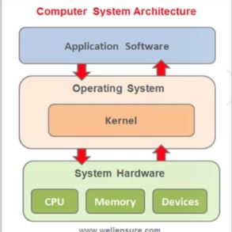
Logical Architecture of a Computer System
The operating system layer hides the details of the hardware from the programmer and provides the programmer with convenient interface for using the system

Slide 6
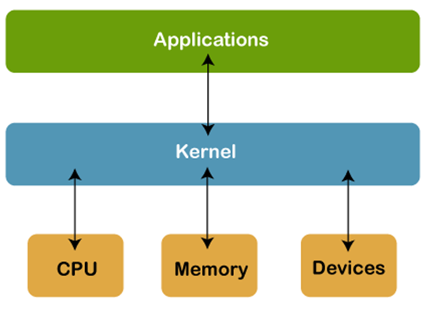
Kernel
The sole aim of kernel is to manage the communication between the software (user level applications) and the hardware (CPU, disk memory etc).
In computing, the kernel is the central component of most computer operating systems; it is a bridge between applications and the actual data processing done at the hardware level.
It acts as an interface between the user applications and the hardware.

Slide 7
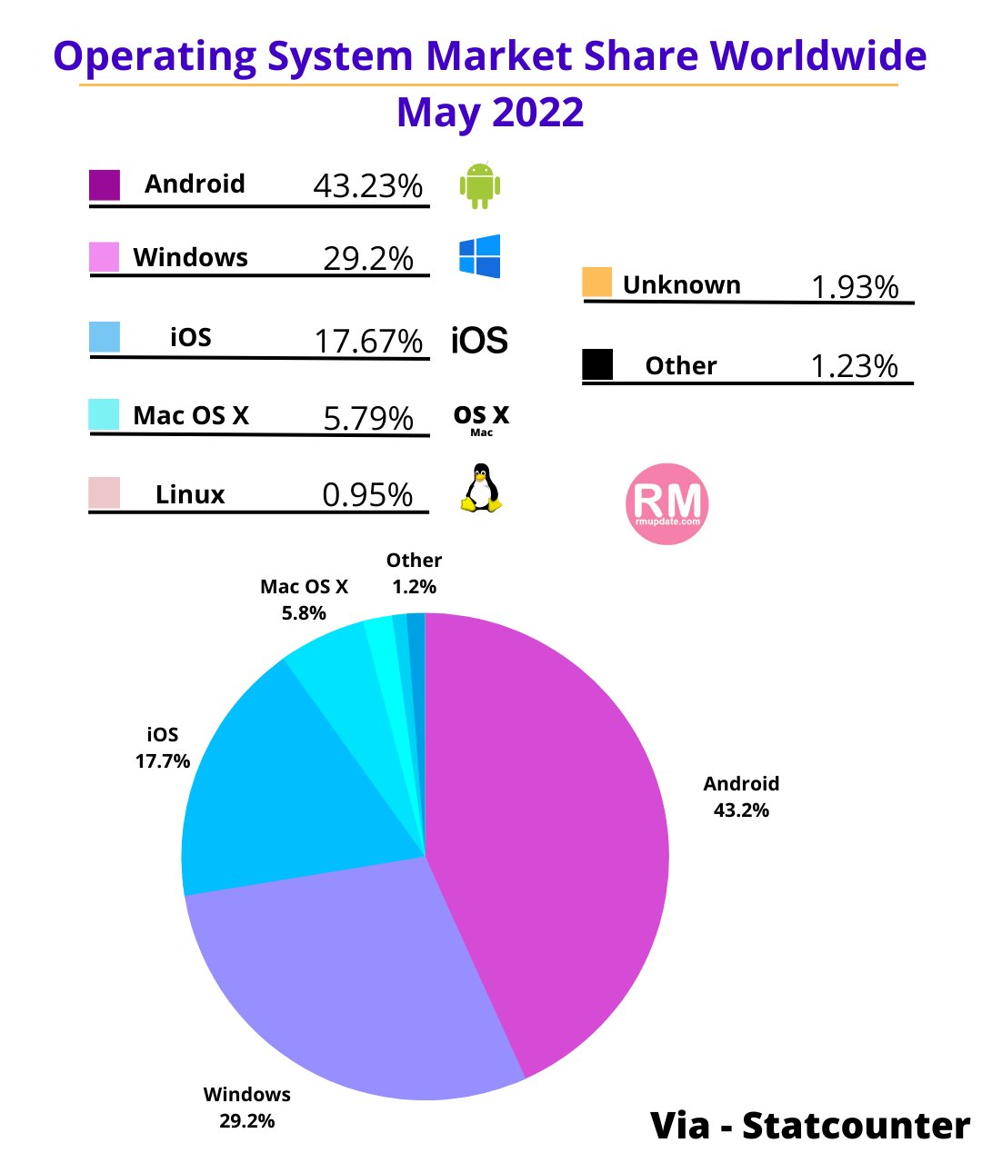

Slide 8
Functions of Operation System
Input/output Management: What output will come from the input given by the user, the operating system runs this program. This management involves coordinating various input and output devices. It assigns the functions of those devices where one or more applications are executed.
Memory Management: The operating system handles the responsibility of storing any data, system programs, and user programs in memory. This function of the operating system is called memory management.
File Management: The operating system is helpful in making changes in the stored files and in replacing them. It also plays an important role in transferring various files to a device.
Process Management: The process is the execution of a program that accomplishes the specified work in that program. It can be defined as an execution unit where a program runs.
Job Priority: The work of job priority is creation and promotion. It determines what action should be done first in a computer system.
Security: Computer security is a very important aspect of any operating system. The reliability of an operating system is determined by how much better security it provides us.

Slide 9
Types of Operating System
Single-user, single task - As the name implies, this operating system is designed to manage the computer so that one user can effectively do one thing at a time.
Ex: MS-DOS is a good example of a single-user, single-task operating system.
Single-user, multitasking - This is the type of operating system most people use on their desktop and laptop computers today.
Ex: Microsoft Windows and Apple's macOS.
Multiuser - A multiuser operating system allows many different users to take advantage of a computer's resources simultaneously.
Ex: Unix, VMS and mainframe operating systems, such as MVS.
Real Time Operating System: Real-time operating systems are used to control machinery, scientific instruments and industrial systems. An RTOS typically has very little user-interface capability, and no end-user utilities since the system will be a "sealed box" when delivered for use
Distributed A part of the distributed Operating system is installed on each machine to make their communication possible. - These operating systems manage multiple computers at the same time.

Slide 10
Computer Program
A computer program is a sequence or set of instructions in a programming language for a computer to execute.
A program gives the computer and user the ability to perform specific tasks.
Application- A program or group of programs that is designed for the end user.
Ex: Amazon app, flip kart, SBI yono app, etc.
Software can be made up of more than one program. The programs and other operating information used by a computer.
Ex: Adobe, MS office, Browsers, Drivers, etc.

Slide 11
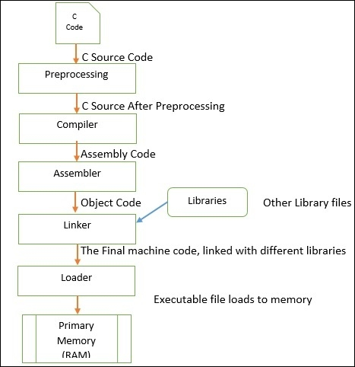
Program execution flow
For the reference, we use here C programming.

Slide 12
Cont…
C Code − This is the code that you have written. This code is sent to the Preprocessors section.
Preprocessing − In this section the preprocessor files are attached with our code. We have use different header files like stdio.h, math.h etc. These files are attached with the C Source code and the final C Source generates. (‘#include’, ‘#define’ These are Preprocessor Directives.)
Compiler − After generating the preprocessed source code, it moves to the compiler and the compiler generates the assembly level code after compiling the whole program.
Assembler − This part takes the assembly level language from compiler and generates the Object code, this code is quite similar to the machine code (set of binary digits).

Slide 13
Cont…
Linker − Linker is another important part of the compilation process. It takes the object code and link it with other library files, these library files are not the part of our code, but it helps to execute the total program. After linking the Linker generates the final Machine code which is ready to execute.
Loader − A program, will not be executed until it is not loaded into Primary memory. Loader helps to load the machine code to RAM and helps to execute it. While executing the program is named as Process. So process is (Program in execution).

Slide 14
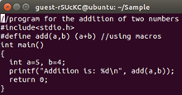
How do we compile and run a C program?
We first create a C program using an editor and save the file as filename.c
$ vi filename.c
$gcc filename.c
$./a.out
Or
$gcc -o hello hello.c
$./hello

